Slide 1


Momentum-Based ETF Trading Strategy
Data-Driven Portfolio Allocation (2010–2024)
By: Shruti Kalaskar
Course: MSDS-451 Financial Engineering
November 23rd, 2025
Notes:
🎤 Slide 1: Title Slide
"Hello everyone, my name is Shruti Kalaskar. I am pursuing my Master's in Artificial Intelligence from the McCormick School of Engineering at Northwestern University."
"This presentation is for my MSDS-451 Term Project titled Momentum-Based ETF Trading Strategy: A Data-Driven Portfolio Allocation Model from 2010 to 2024. I’ll walk you through the motivation, design, execution, and results of my rules-based trading algorithm designed to beat the market."

Slide 2
Project Overview
Goal: Implement a systematic momentum-based trading strategy
Asset class: U.S. Tech & Bond ETFs (QQQ, VGT, XLK, TLT)
Method: Monthly rebalancing based on momentum and trend filters
Period: 2010–2024
Notes:
"My goal was to design a systematic investment strategy that leverages momentum and trend-following signals to select the best-performing ETFs monthly.
I implemented a long-only momentum strategy across tech ETFs, with a bond ETF included for diversification. The strategy relies on monthly rebalancing and simple technical indicators. I used Python for the entire backtest, including signal generation, filtering, allocation, and performance evaluation."

Slide 3

Strategy Philosophy
Buy High, Sell Higher using recent performance (momentum)
Trend confirmation using 50-day and 200-day SMAs
Risk management via diversification (bond ETF)
Monthly signal refresh to capture changing market dynamics
Notes:
"The core idea is simple: Buy high, sell higher. Momentum investing assumes that assets with strong recent performance tend to keep performing well in the short-term.
I used 20-day price momentum as the primary ranking signal, and combined that with trend confirmation via the 50-day and 200-day Simple Moving Averages. Monthly rebalancing ensures the portfolio remains adaptive to market shifts, and bond ETFs were considered to reduce portfolio correlation."**

Slide 4
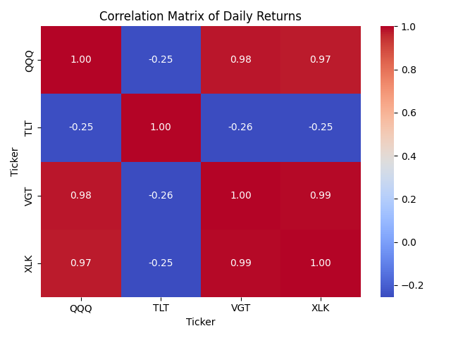
Asset Universe & Correlation Insights
Tech ETFs: QQQ, VGT, XLK
Diversifier: TLT (Bond ETF)
Correlation between tech assets ≈ +0.97
TLT shows negative correlation (~-0.25)
Notes:
"The ETF universe includes three tech-sector funds: QQQ, VGT, and XLK, and one bond ETF, TLT, for diversification.
You can see in the correlation matrix that the tech ETFs are highly correlated—around +0.97. TLT, however, is negatively correlated at -0.25, which is helpful during equity drawdowns. This insight supported its inclusion as a potential diversifier in the strategy."**

Slide 5
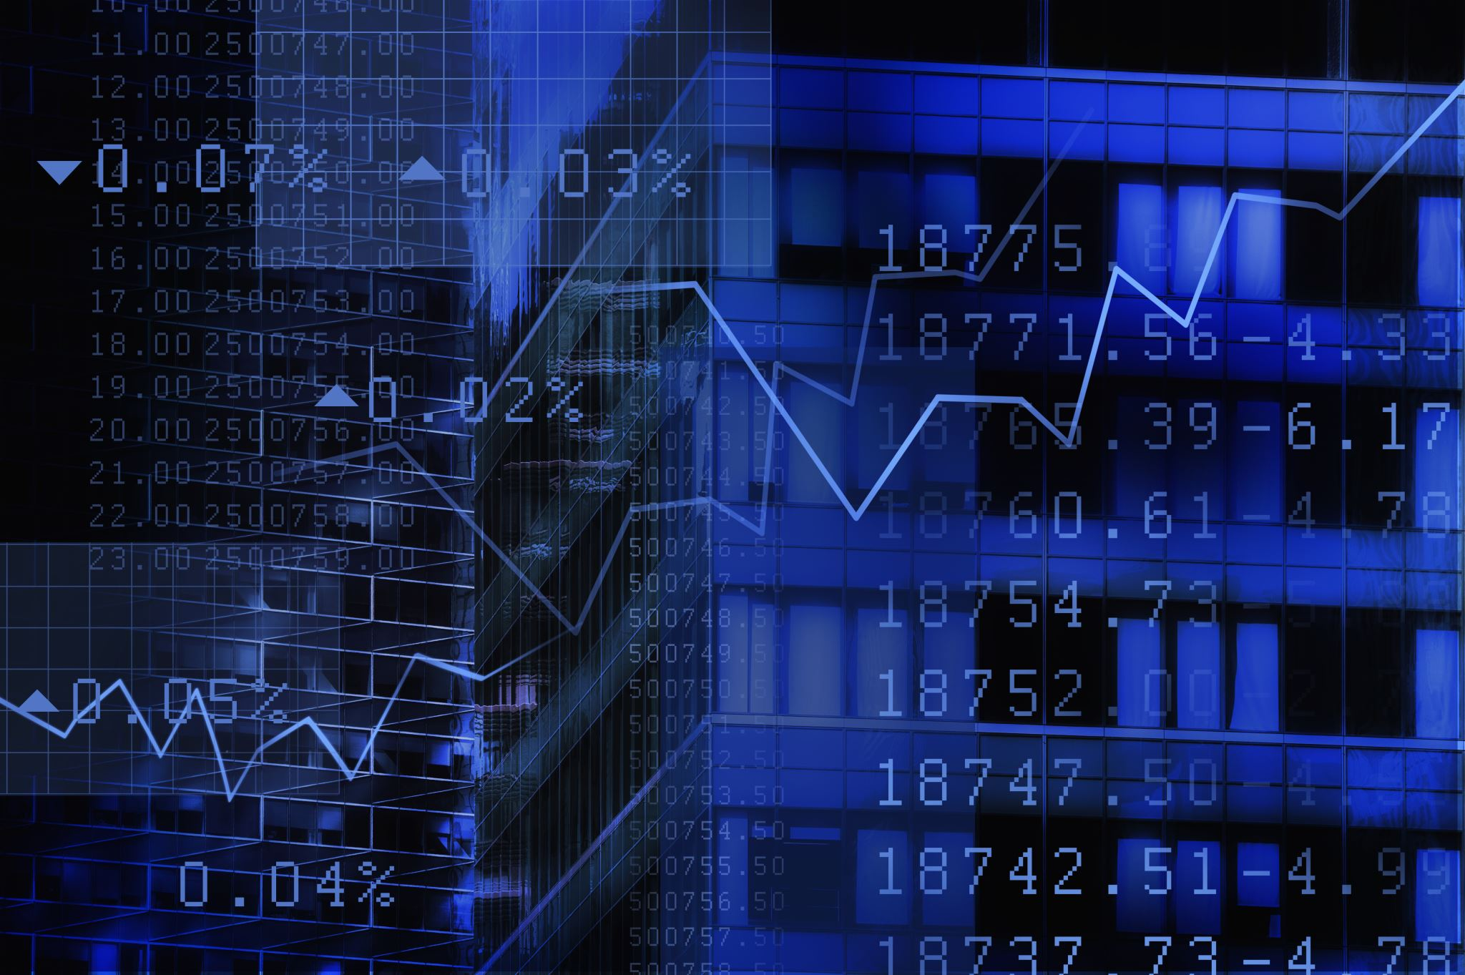
Strategy Rules & Logic
Signal Generation:
Momentum = 20-day % price change
SMA filter: Price must be above 50 & 200-day SMA
Top 2 ranked ETFs chosen monthly
Allocation:
Equal weight: 50% each
Monthly rebalancing
Notes:
"Here’s a breakdown of the strategy mechanics:
Each month, I calculate 20-day momentum for each ETF.
I filter out any ETF trading below both its 50-day and 200-day SMA.
From the remaining ETFs, the top two are selected.
The portfolio allocates 50% to each of these top-ranked ETFs and rebalances monthly."**

Slide 6
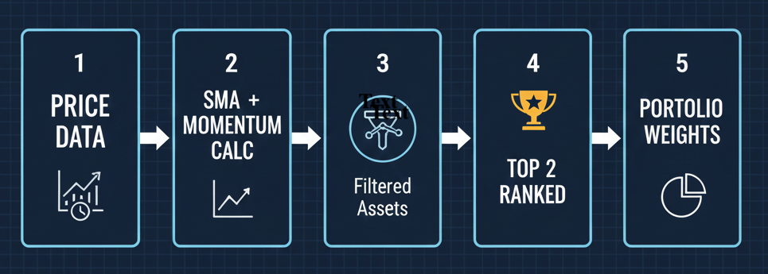
Monthly Rebalancing Process
Momentum & trend signals recalculated monthly
ETFs failing SMA filter are excluded
Dynamic adaptation to market regimes
Notes:
"This flowchart outlines the full decision-making pipeline. Every month:
New price data is used to calculate momentum and SMA signals.
The filter is applied.
The top 2 ETFs are ranked by momentum and given equal weight.
If no ETF passes the SMA filter, the portfolio stays in cash or previous positions."**

Slide 7
Performance Summary (2010–2024)
Metric | Value
Total Return | 545.5%
Annualized Return | 15.0%
Annualized Volatility | 16.3%
Sharpe Ratio | 0.92
Max Drawdown | -42.3%
Notes:
"This shows the cumulative returns of the strategy over 14 years. The strategy returned over 545%, with an annualized return of about 15%, which is significantly higher than the S&P 500 during the same period.
The Sharpe ratio was 0.92, reflecting strong risk-adjusted returns, and the maximum drawdown was -42%, which occurred during a volatile market phase.**
While the drawdown is non-trivial, the strategy still delivered consistent returns with lower volatility than individual tech ETFs."**

Slide 8
Key Insights & Observations
Strategy avoided major losses during downtrends
Outperformance due to momentum rotation
Bond ETF helped reduce drawdowns
Rule-based logic removed emotion from trading
Notes:
"Here are some important findings:
The SMA filter helped avoid major downturns during bearish markets.
The monthly rebalancing allowed the strategy to adapt dynamically to market trends.
TLT provided valuable diversification, especially when tech momentum faded.
Overall, combining momentum with simple risk filters proved effective over multiple market regimes."**

Slide 9
Future Strategy Enhancements
Add volatility-adjusted momentum (Sharpe/MAR ranking)
Apply bull/bear regime filters
Adaptive position sizing (e.g., inverse volatility)
Simulate transaction costs/slippage
Expand ETF universe (international, small-cap, sectors)
Notes:
"For future improvements, I plan to test volatility-adjusted momentum using Sharpe or MAR ratios.
I also want to implement bull/bear regime filters, adapt position sizing based on inverse volatility, and test how transaction costs would impact net returns.
Expanding the ETF universe to include small-cap or international assets could further enhance diversification."**

Slide 10
Management Recommendation
Start a fund based on this model? Yes
Transparent and systematic strategy
Robust performance with limited asset set
Data-driven & replicable
Notes:
"Based on the results, I would recommend starting a fund with this strategy. It’s transparent, rules-based, and adaptable.
If I were to join the fund, I’d take the role of Quantitative Researcher to enhance the core algorithm using macro signals and reinforcement learning techniques.
I would also invest in this fund personally, as it aligns with a growth-oriented, risk-aware investment philosophy."**

Slide 11
My Role & Vision Forward
Ideal role: Quantitative Researcher
Enhance strategy with macro signals and regime switching
Apply similar logic to futures or options
Promote fund to growth-focused investors
Notes:
"As the sole researcher and developer of this strategy, I performed all data cleaning, signal generation, backtesting, and performance evaluation using Python and pandas.
My vision is to extend this strategy into a fully autonomous agent-based trading bot that can operate across multiple markets in real time, integrating reinforcement learning and real-world news sentiment."**

Slide 12
Thank you
Notes:
"Thank you for taking the time to watch my presentation.

